Slide 1
CO2 emissions around the world
Presentation by: Shree & Mahaprasad

Slide 2
Data Dictionary
Repository of information about data elements in a database.
It contains metadata, such as data type, size, and format, and any applicable constraints.
facilitate communication and ensure accuracy in data processing and analysis.

Slide 3
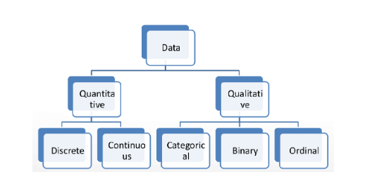
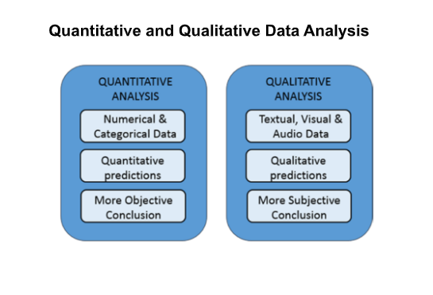
Types of data analysis

Slide 4
SRNO | Attribute name | Attribute definition | Broad category | Sub category | Scale of Measurement
1 | Country Name | Name of country | Qualitative | - | Nominal
2 | Country Code | Unique code of country | qualitative | - | Nominal
3 | Region | Country lie in which continents | qualitative | - | Nominal
4 | Indicator Name | CO2 emissions (metric tons per capita) | qualitative | - | Nominal
5 | 1990 | From which year we have data | quantitative | Continuous | Ratio
6 | 1991 | …….. | quantitative | Continuous | Ratio
7 | 2018 | ……….. | quantitative | Continuous | Ratio
8 | 2019 | Till date | quantitative | Continuous | Ratio

Slide 5
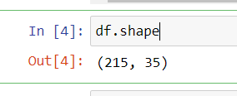
Dataset size
215 rows, 35 columns

Slide 6
Descriptive Statistics
Involves collecting, analyzing, and presenting data to summarize its features.
It includes measures such as mean, median, mode, variance, and standard deviation, etc.

Slide 7
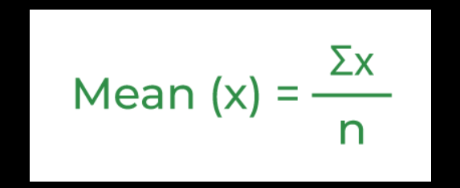
Mean
the mean is a measure of central tendency that represents the average value of a dataset. It is calculated by adding up all the values in the dataset and dividing by the total number of values.

Slide 8
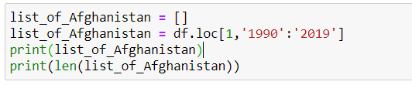
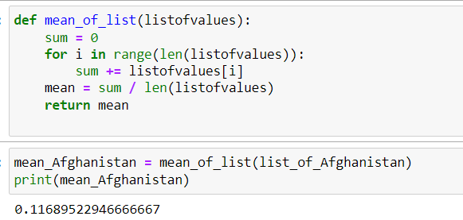

Afghanistan’s analysis
Average emission over the years

Slide 9
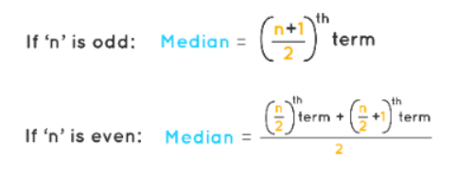
Median
To calculate the median, the dataset is first arranged in order from lowest to highest (or highest to lowest). Then, the middle value is identified. If there is an odd number of values in the dataset, the median is the middle value. If there is an even number of values, the median is the average of the two middle values.

Slide 10
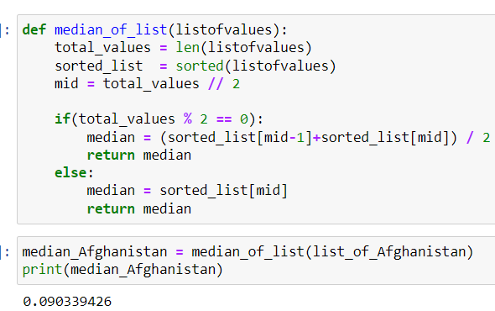
Median emission over the years

Slide 11
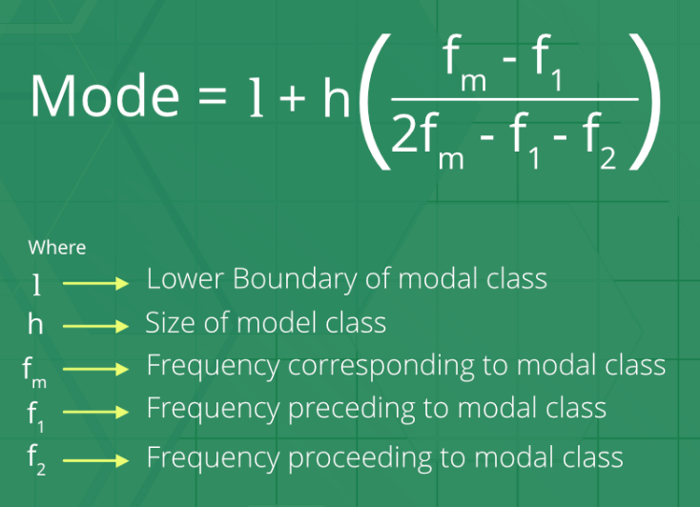
Mode
the mode is a measure of central tendency that represents the most common value or values in a dataset. The mode is the value that appears most frequently in the dataset. A dataset can have multiple modes if there are multiple values that appear with the same highest frequency.

Slide 12
Mode Emission Over The Years
Not possible to find since there are no repeating values

Slide 13
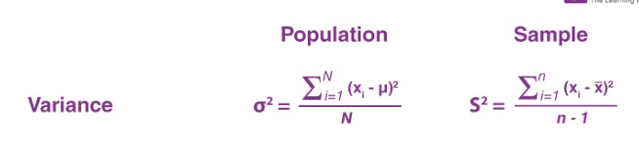
Variance
the variance is a measure of the spread or dispersion of a dataset around its mean. It is calculated by taking the sum of the squared differences between each value in the dataset and the mean, and then dividing this sum by the total number of values in the dataset minus one. A higher variance indicates that the data points are more spread out from the mean, while a lower variance indicates that the data points are more tightly clustered around the mean

Slide 14
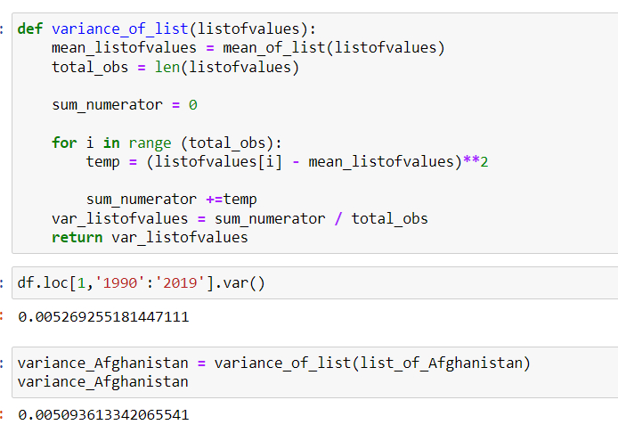
Variance Emission Over The Years

Slide 15
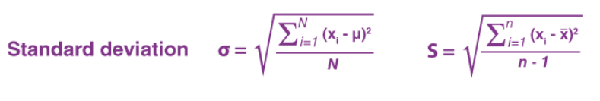
Standard Deviation
the standard deviation is a measure of the amount of variation or dispersion of a dataset around its mean. It is calculated as the square root of the variance, which is the sum of the squared differences between each value in the dataset and the mean, divided by the total number of values in the dataset minus one. A higher standard deviation indicates that the data points are more spread out from the mean, while a lower standard deviation indicates that the data points are more tightly clustered around the mean.

Slide 16
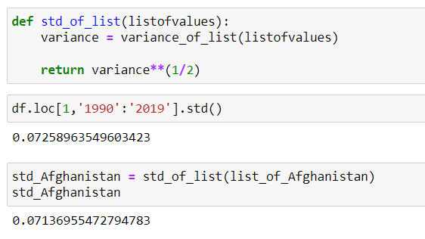
Standard Deviation Emission Over The Years

